Slide 1



Slide 2

Real-Time Network Intrusion Detection Using Wireshark and Advanced Ensemble Learning Techniques

Slide 3
Group Members Introduction
Wasif Nawaz
BC210424643
Final Year Software Engineering Student
Samar Asad
BC210401276
Final Year Software Engineering Student

Slide 4

INTRODUCTION OF PROJECT
Project Title:
Real-Time Network Intrusion Detection Using Wireshark and Advanced Ensemble Learning Techniques
Objective:
To develop an intelligent IDS that detects malicious network activity in real-time using machine learning and live traffic analysis.
Why This Project?
  Increasing frequency and complexity of cyber attacks
  Traditional systems lack real-time adaptability
  Need for intelligent, data-driven security tools
Core Components:
  Network traffic capture via Wireshark
  Data preprocessing and feature engineering
  Classification using TabNet, CatBoost, LightGBM
  User-friendly web interfacefor interaction

Slide 5
INTRODUCTION OF PROJECT
(Scope & Benefits)
Target Users:
  Network administrators
  Cybersecurity professionals
  Academic researchers
Key Features:
  Real-time or file-based intrusion detection
  Confidence scoring and analytics dashboard
  Feedback loop for model improvement
  Role-based web access (Admin/User)
Technologies Used:
  Python, Flask, Wireshark
  Machine learning libraries: Scikit-learn, CatBoost, LightGBM, TabNet
  Database: SQLite/MySQL
Expected Outcome:
A complete, scalable, and modular IDS that provides real-time threat detection with actionable insights via a web interface.

Slide 6
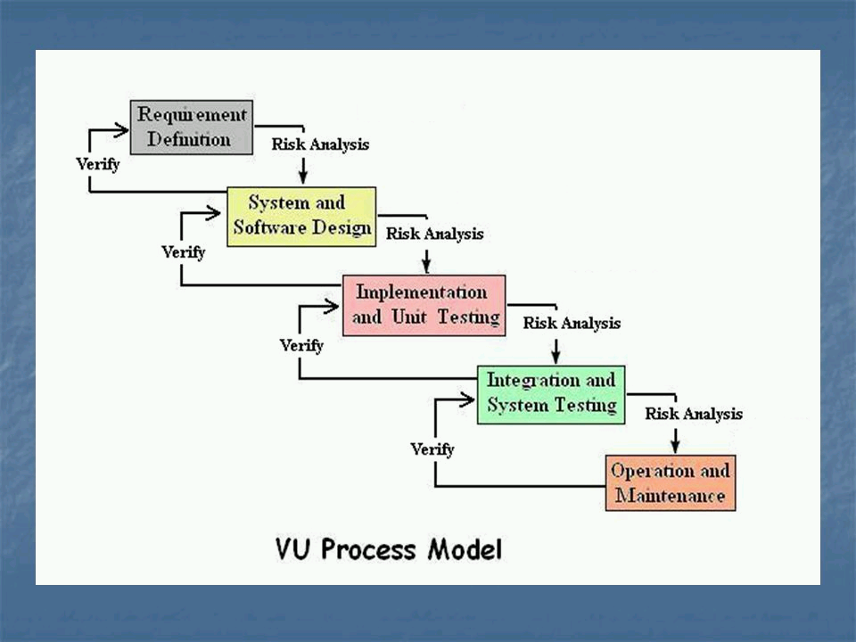
Process Model Diagram

Slide 7
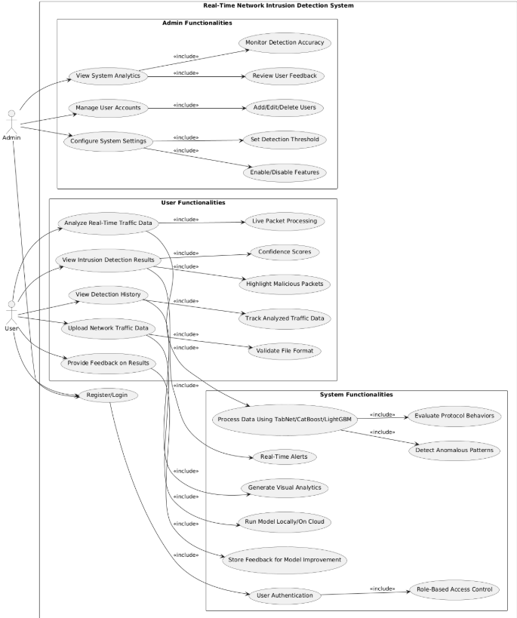
Use Case Diagram

Slide 8
Business Rules Catalog
Below are the core functional requirements that define how the system should behave and operate:
General Requirements:
  Users must be able to upload .csv network traffic files.
  The system shall classify data using trained ML models.
  Detection results must be displayed with confidence scores.
Module-Specific Requirements:
  Data Capture: Wireshark shall capture and export traffic to .csv with relevant features.
  Preprocessing: System shall clean, encode, and normalize traffic data automatically.
  Model Evaluation: ML models must be evaluated using accuracy, recall, and F1-score.
  Web Interface: Users shall interact via a Flask/Django-based web app.

Slide 9
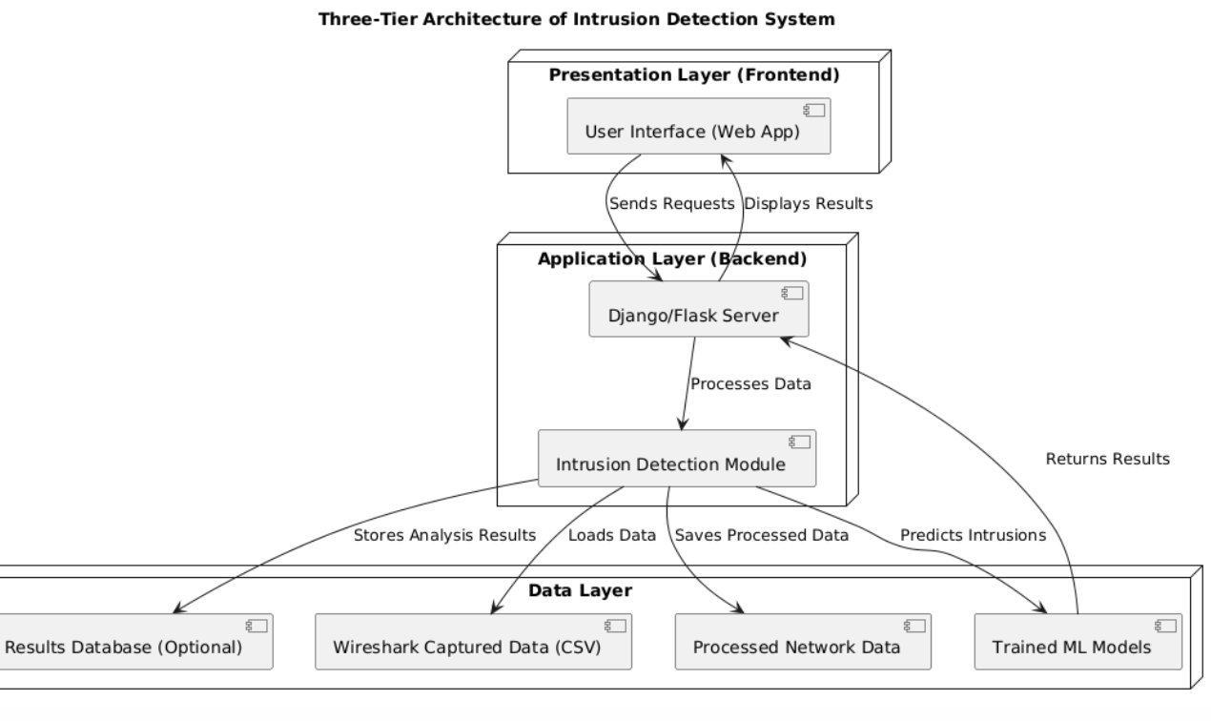
Architectural Design
Provide Architecture Diagram Here

Slide 10
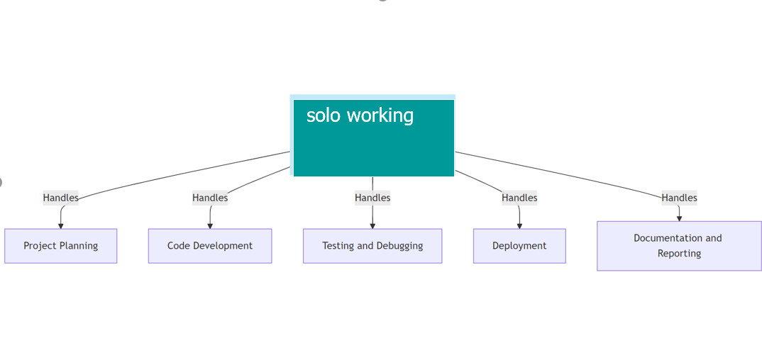
Team Structure

Slide 11
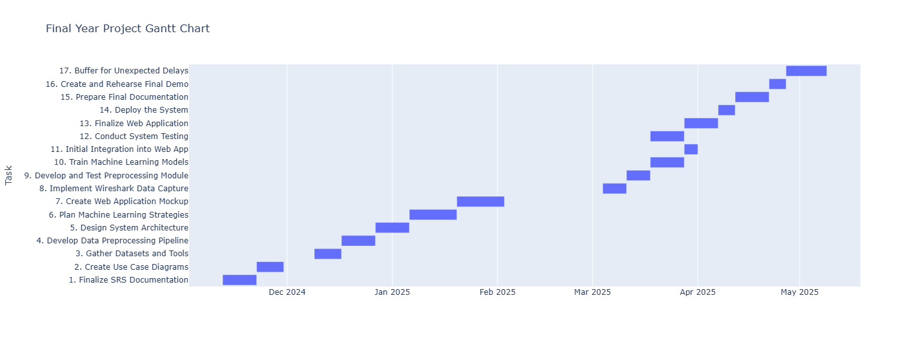
Project Schedule
Provide the Schedule (Gantt Chart) of your
project here.

Slide 12
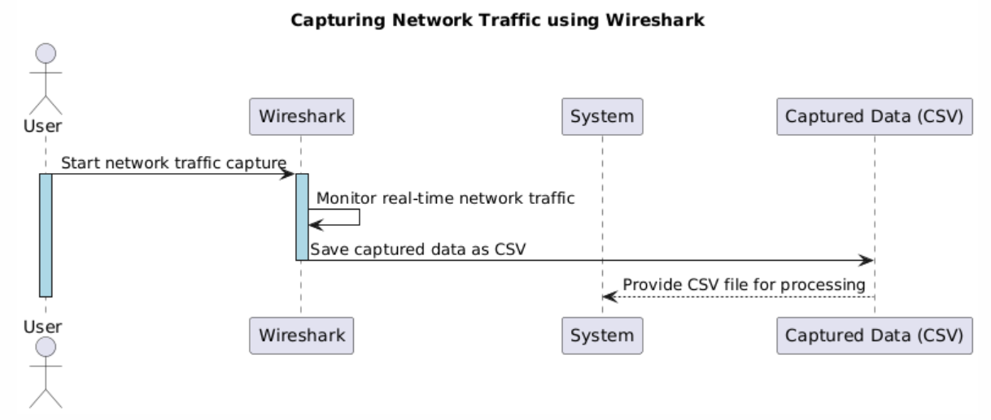
Sequence Diagrams
Sequence Diagrams
Diagrams: 01

Slide 13
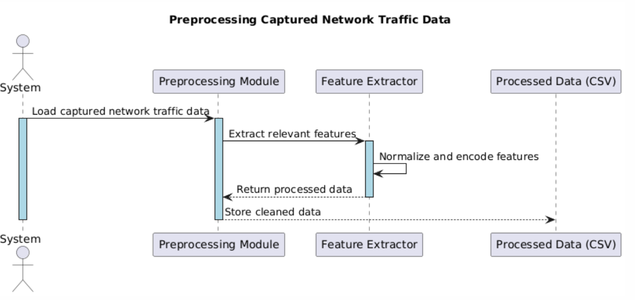
Sequence Diagrams
Sequence Diagrams
Diagrams: 02

Slide 14
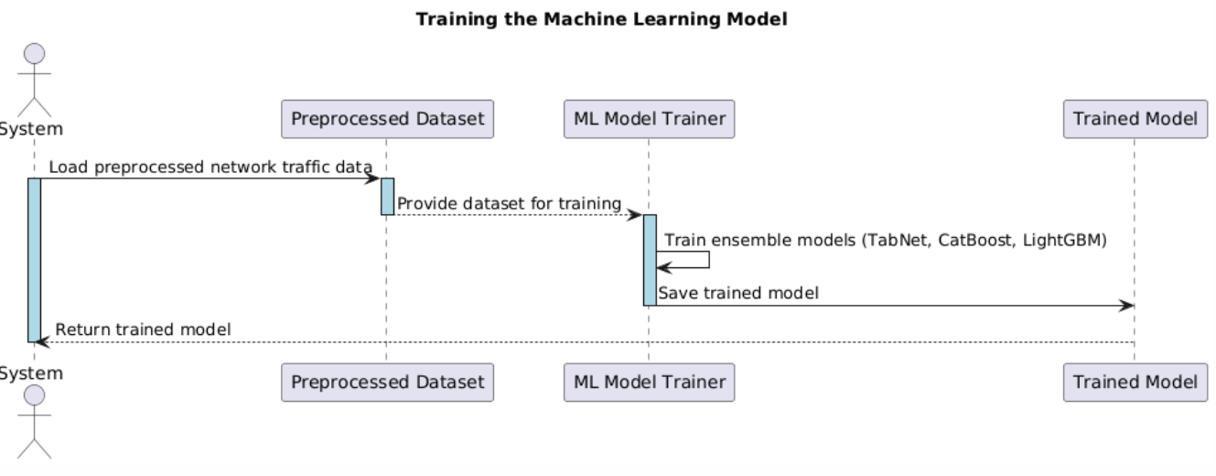
Sequence Diagrams
Sequence Diagrams
Diagrams: 03

Slide 15
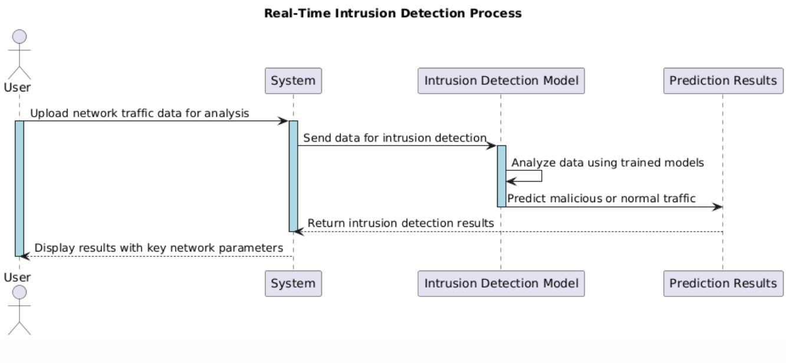
Sequence Diagrams
Sequence Diagrams
Diagrams: 04

Slide 16
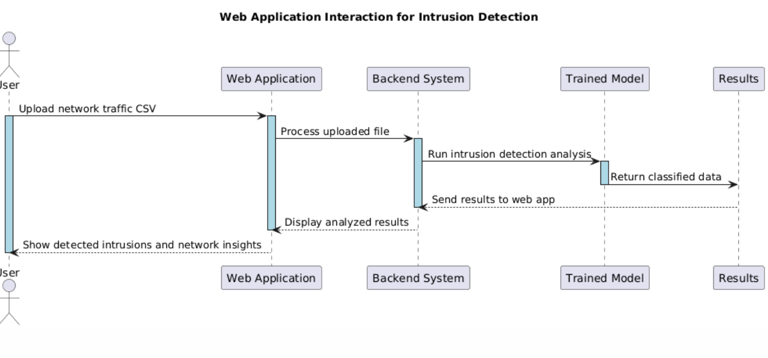
Sequence Diagrams
Sequence Diagrams
Diagrams: 05

Slide 17
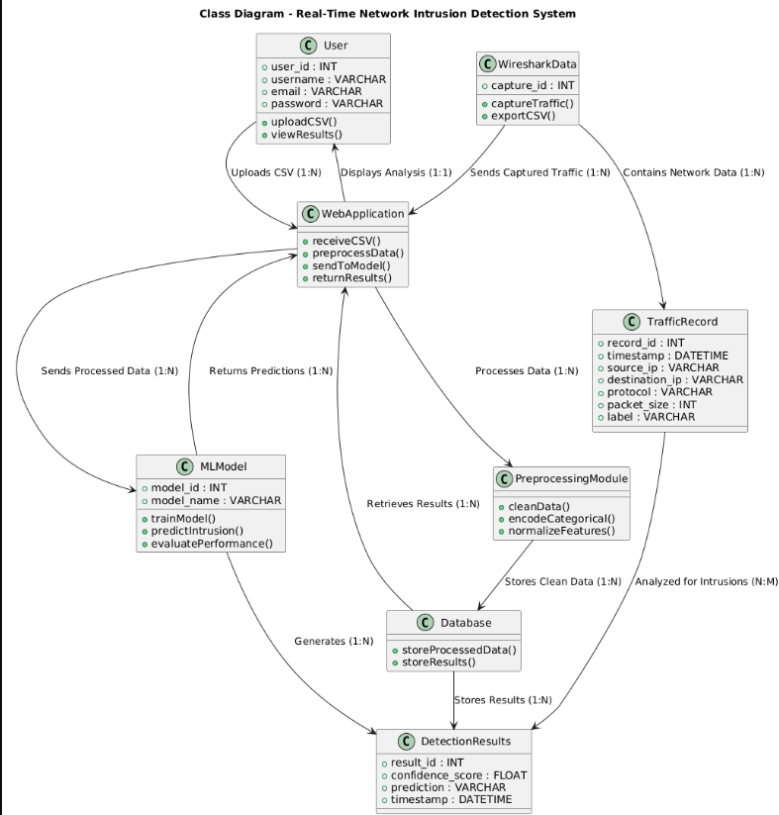
Logical Model/Class Diagram

Slide 18
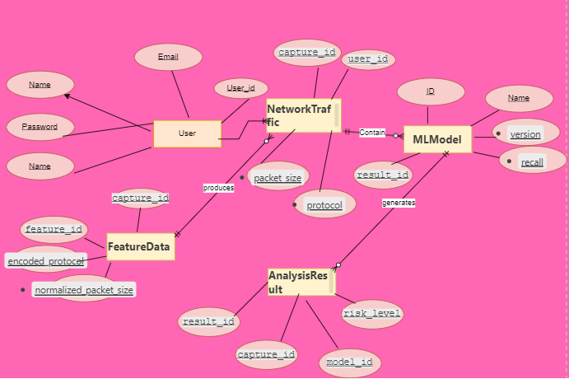
Entity-Relationship Diagram

Slide 19
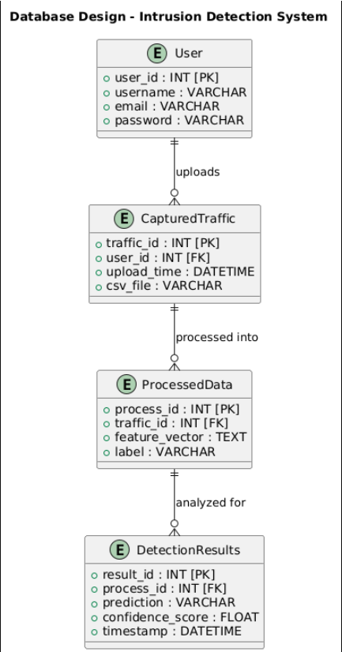
Database Diagram

Slide 20
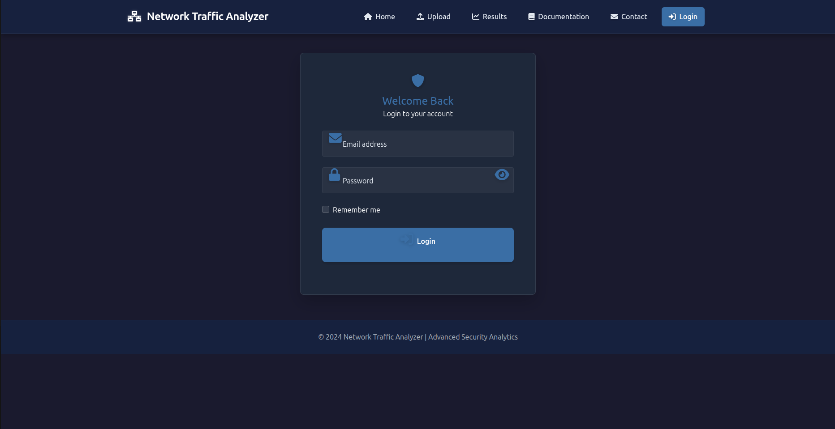
User Interfaces

Slide 21
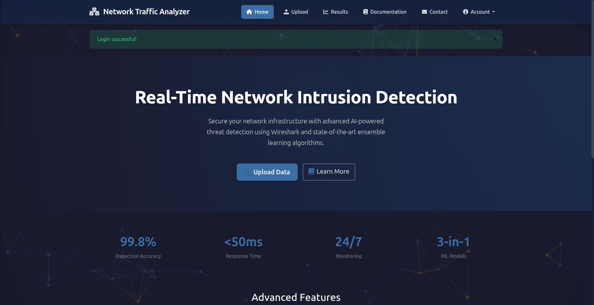
User Interfaces

Slide 22
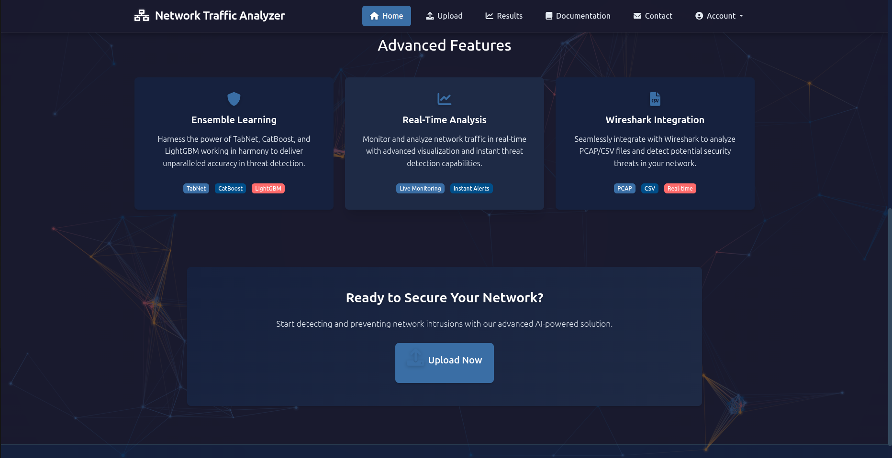
User Interfaces

Slide 23
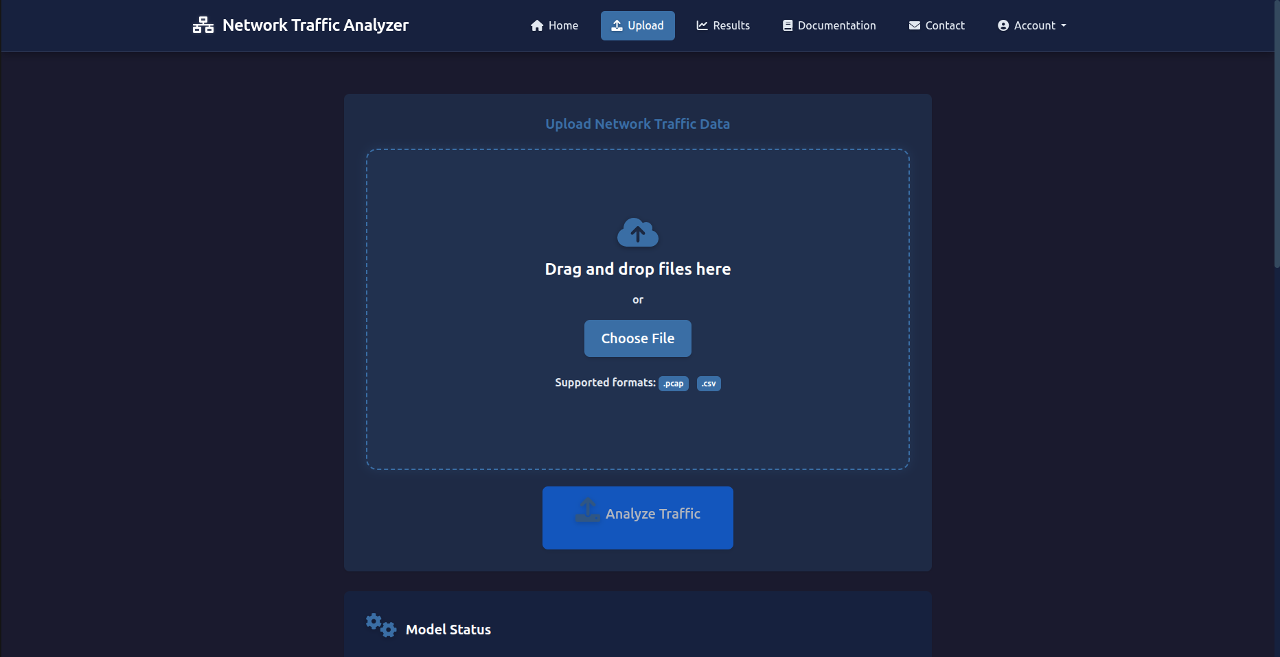
User Interfaces

Slide 24
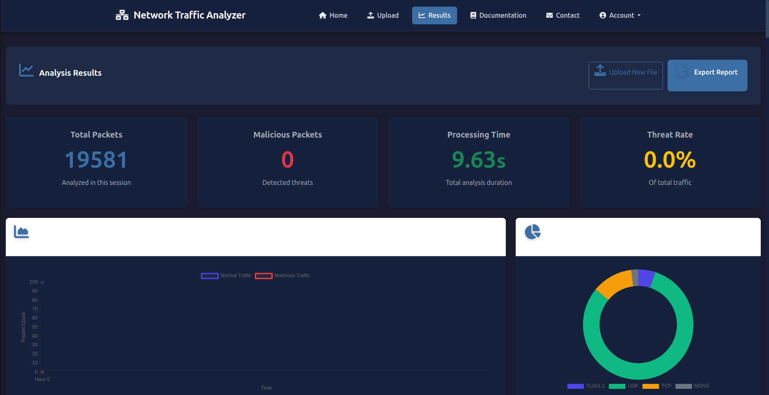
User Interfaces

Slide 25
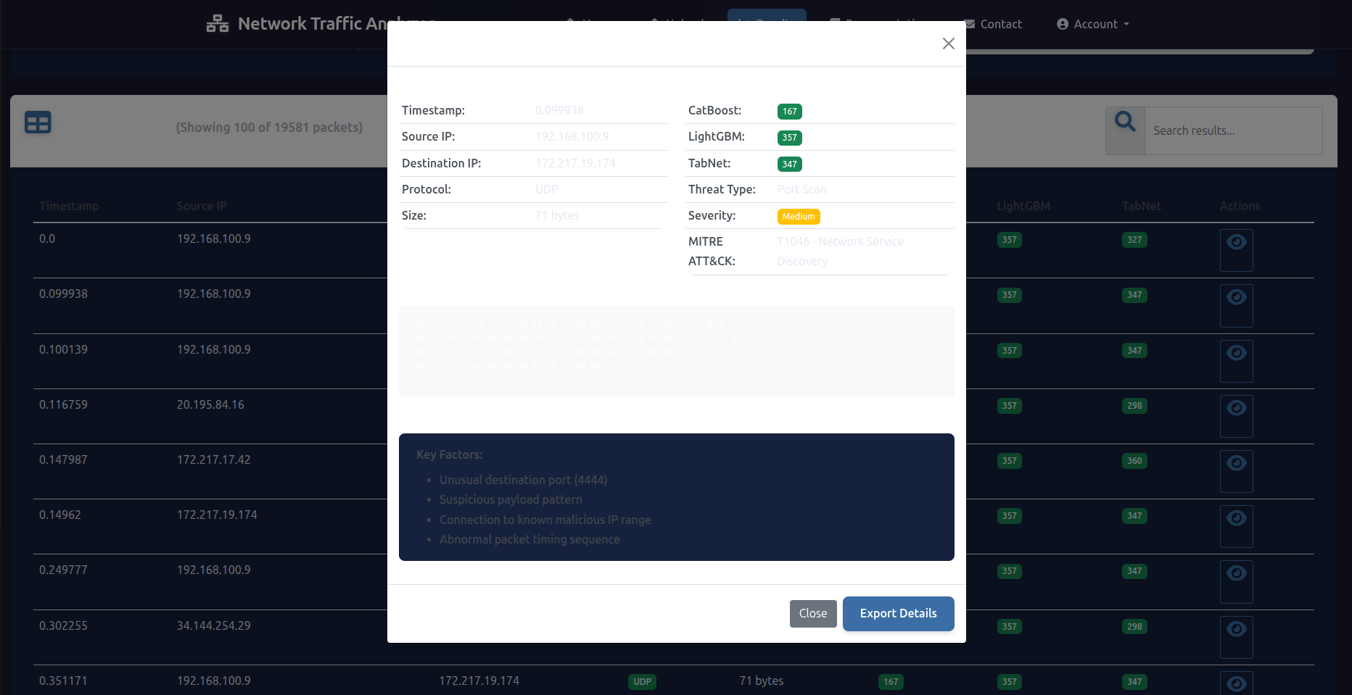
User Interfaces

Slide 26
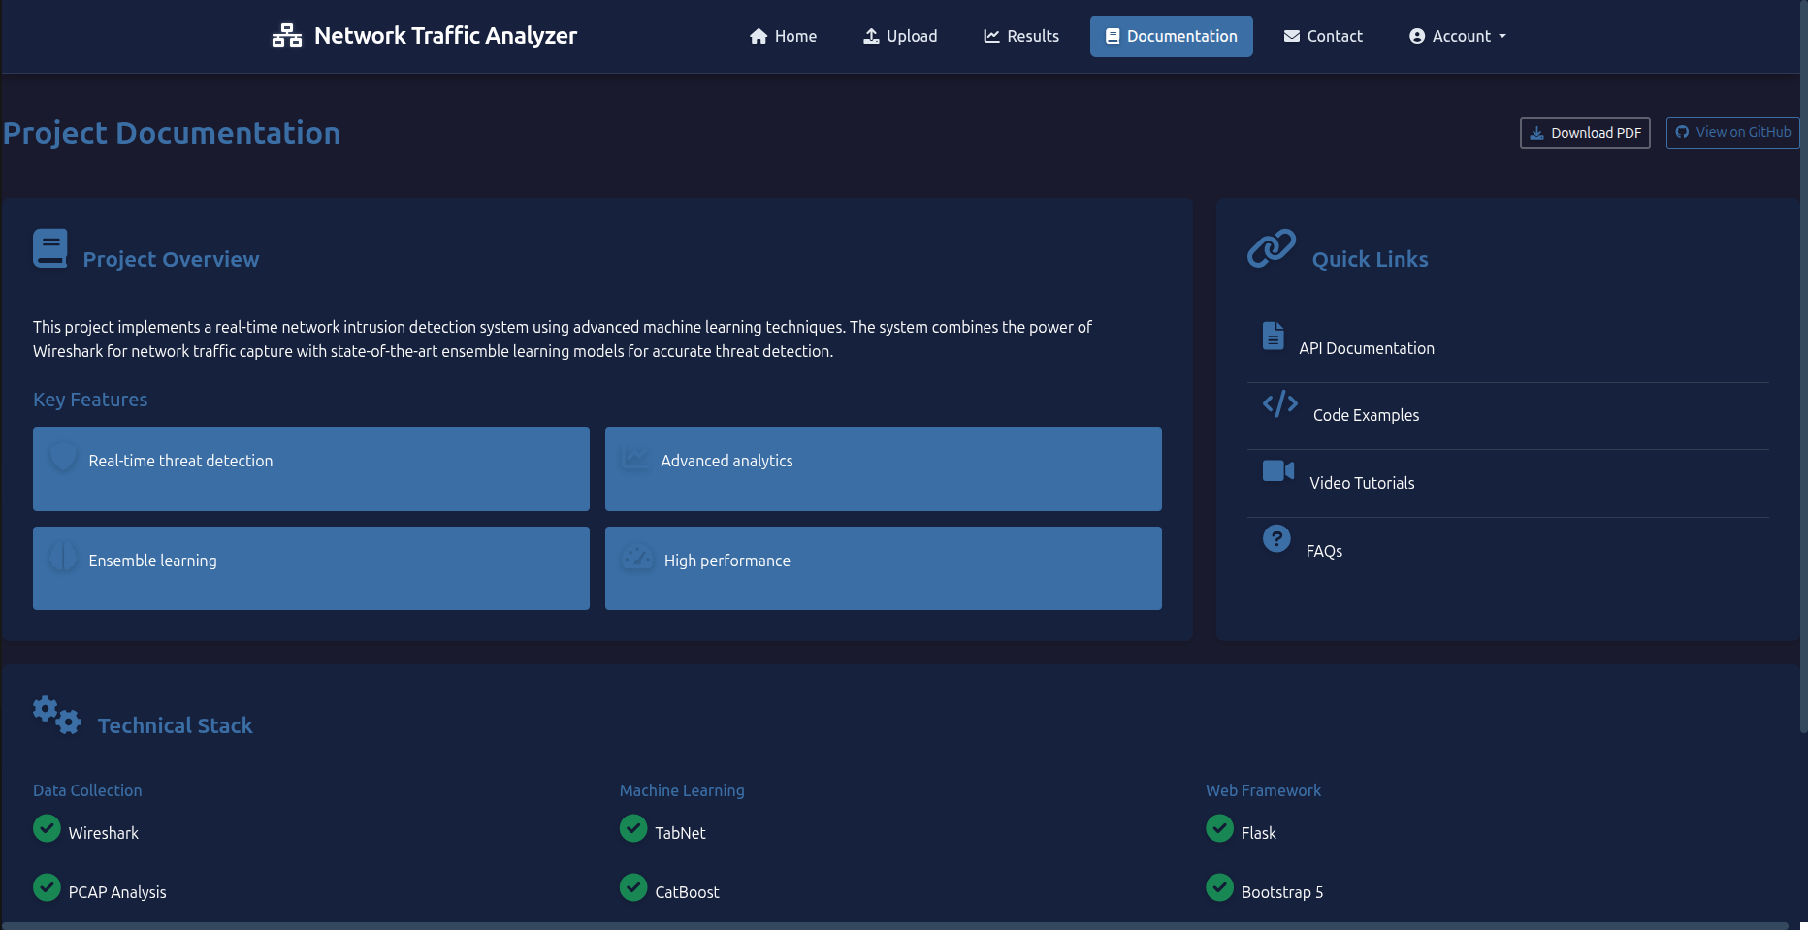
User Interfaces

Slide 27
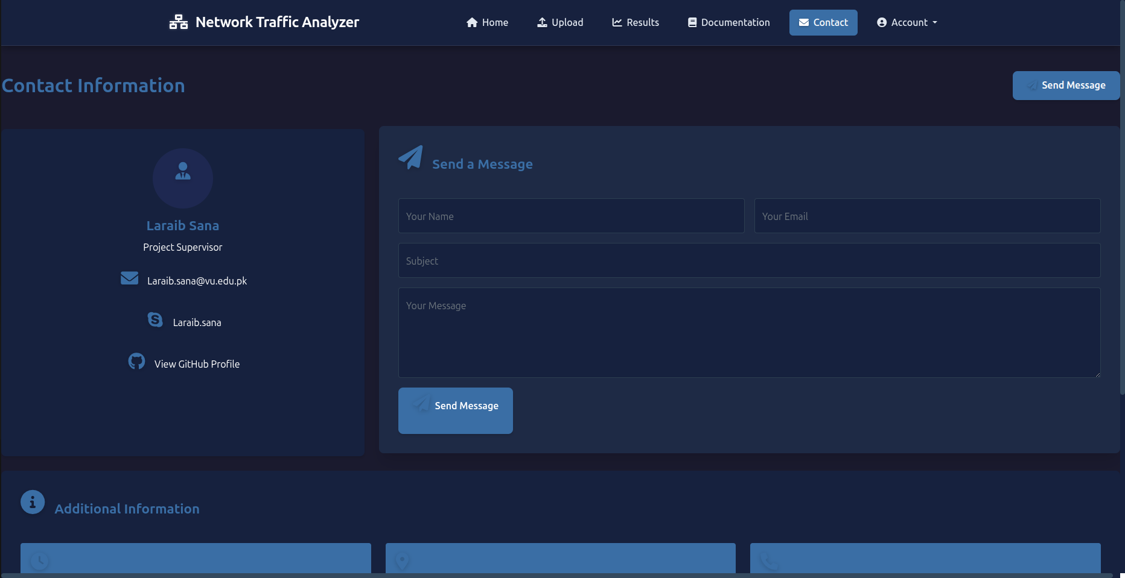
User Interfaces

Slide 28
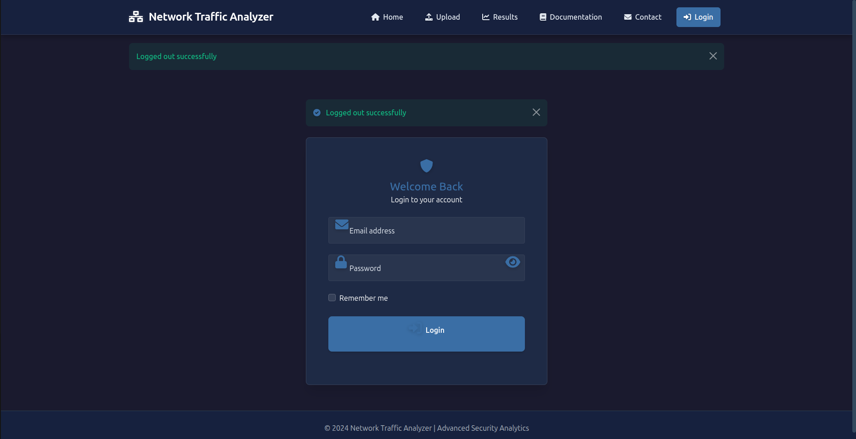
User Interfaces

Slide 29
Tools
🛠 Development Tools
  Python – Core programming language for backend and ML modules
  Jupyter Notebook – Model training and exploratory data analysis
  PyCharm / VS Code – Application development and code debugging
  GitHub – Version control and collaborative coding
🌐 Web Development
  Flask – Web framework for building the user interface and routing
  HTML/CSS, Bootstrap – Interface styling and layout
📡 Network Traffic Capture
  Wireshark – Capturing real-time network packets from the system interface

Slide 30
Tools
🤖 Machine Learning
  Scikit-learn – Preprocessing, model evaluation
  LightGBM, CatBoost, TabNet – Ensemble learning models for classification
  Pandas / NumPy – Data manipulation and feature processing
📊 Visualization & Database
  Matplotlib / Seaborn – Graphical representation of detection results
  SQLite / MySQL – Storing user data, traffic logs, and results
  MySQL Workbench / dbdiagram.io – Database design
🧰 Other Tools
  Draw.io / Lucidchart – Diagrams (ERD, Class, Architecture)
  Microsoft Project / Excel – Gantt chart and project timeline

